Slide 1

STOCKX
Stock Market Predictor and Analyzer

Slide 2
ABOUT THE PROJECT
StockX is an innovative and advanced stock market analysis and prediction project designed to empower investors with insights of market.
In the dynamic landscape of the financial markets, having a reliable and data-driven approach to decision-making is crucial.

Slide 3
OBJECTIVES
The objective of StockX is to provide a user-friendly platform that simplifies stock market analysis and decision-making.

Slide 4
FEATURES
Real-Time Market Data
Predictive Modelling
StockX provides users with up-to-the-minute market data, ensuring that they have access to the latest information on stock prices, trading volumes, and other relevant metrics.
Leveraging advanced machine learning algorithms, StockX offers predictive modeling capabilities, allowing users to anticipate potential market movements and make informed decisions.
Market Sentiment
StockX goes beyond traditional market data by integrating a powerful News Sentiment Analysis feature, providing users with real-time insights

Slide 5
TECHNOLOGIES USED
HTML, CSS, JavaScript
Flask
Roberta
SARIMAX
BeautifulSoup
Pandas, NumPy, etc.…

Slide 6
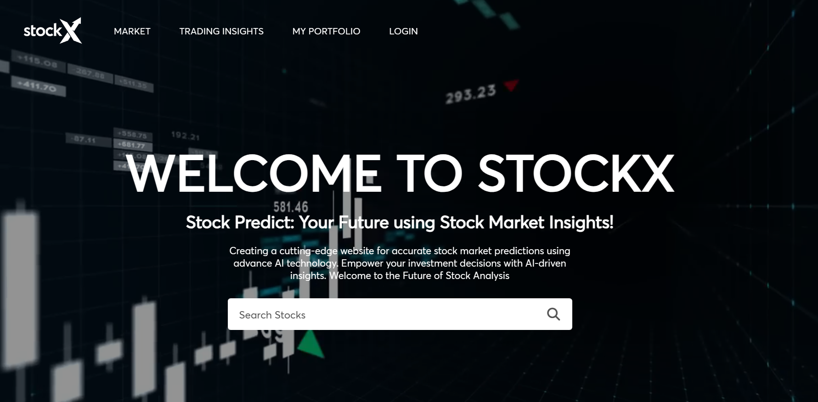
Home Page

Slide 7

Home Page…

Slide 8
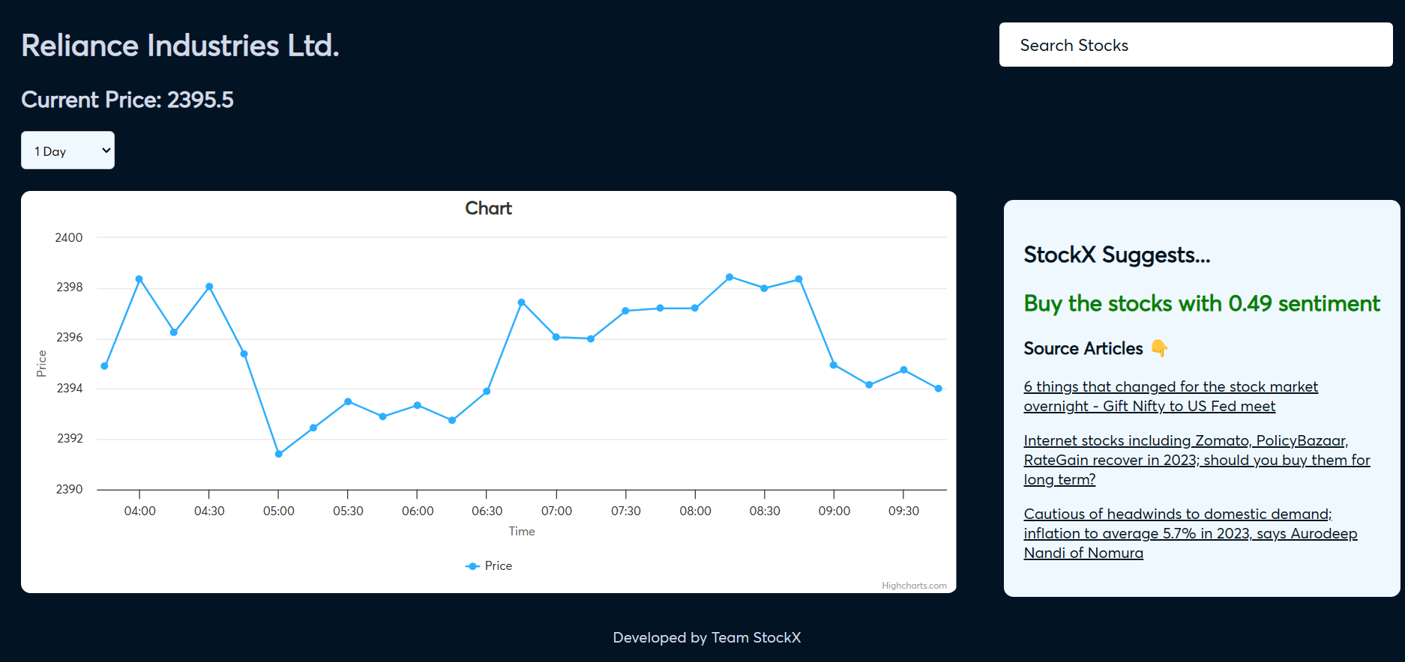
Stock Data - 1 Day

Slide 9
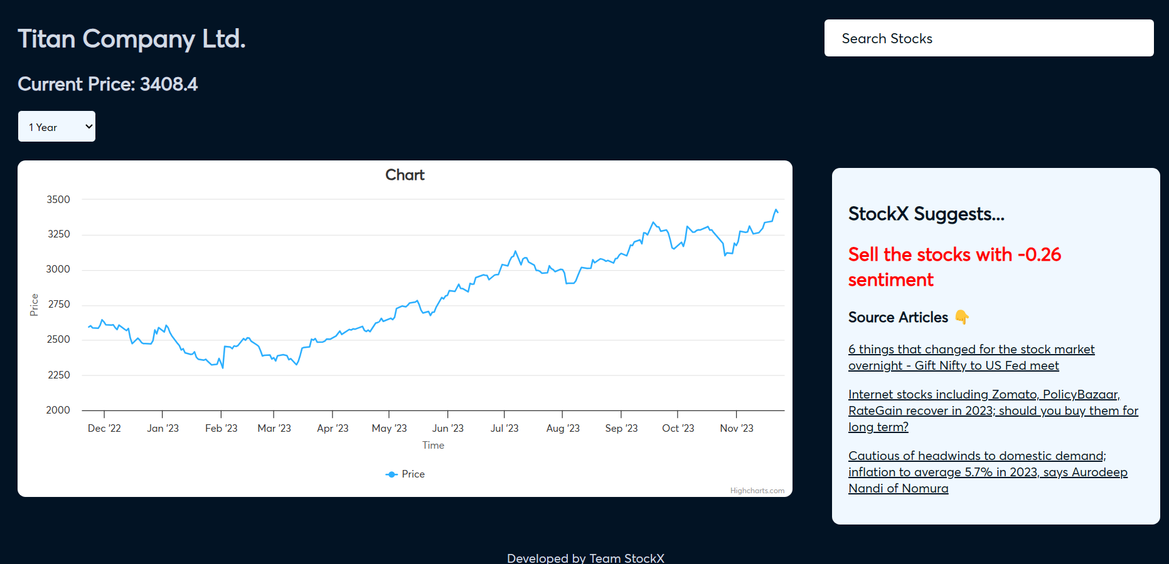
Stock Data - 1 Year

Slide 10
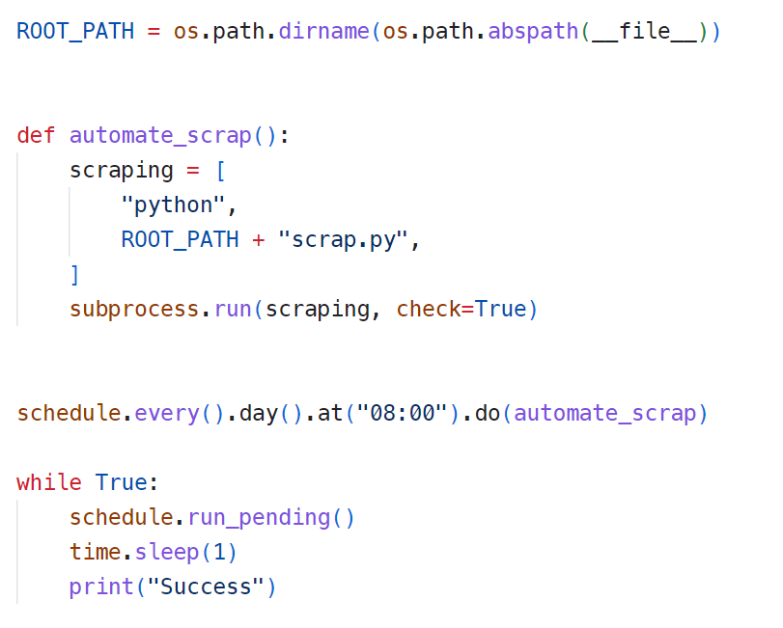
Web Scraping Automation

Slide 11
FUTURE SCOPE
Expanding to more companies
Enhanced Predictions
Deployment & Complete Automation
Mobile App

Slide 12

THANKS!
Adit Shah 21BCP419
Harsh Shah 21BCP359
Karan Shah 21BCP377
Kushagra Darji 21BCP387
Vandeet Shah 21BCP403

